Slide 1
Unit 3

Slide 2
Organized Patterns Catalogue

Slide 3
Organizing the Catalog
Purpose – reflects what pattern does
Creational – concern the process of object creation
Structural – deal with the composition of classes or objects
Behavioral – characterize the ways in which classes or objects interact and distribute responsibility
Scope – whether the pattern applies primarily to classes or to objects
Class – deal with relationships between classes and their subclasses – inheritance – static – fixed at compile time
Object – deal with object relationships – changed at runtime – more dynamic

Slide 4
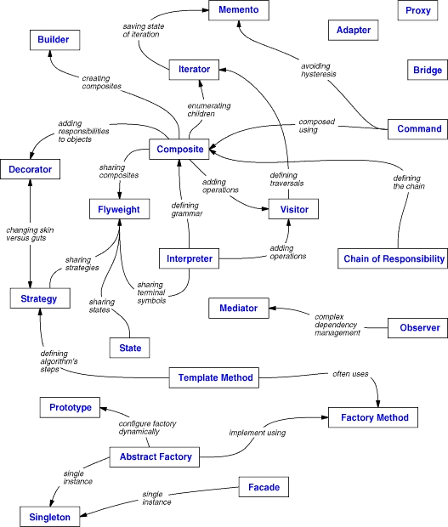

Slide 5
Adapter Design Pattern
Falls into Structural pattern
Object adapter and Class adapter pattern
Many times two classes are incompatible because of incompatible interfaces
Adapter pattern helps us to wrap a class around the existing class and make the classes compatible with each other.
Match interfaces of different classes.

Slide 6

Adapter - definition

Slide 7
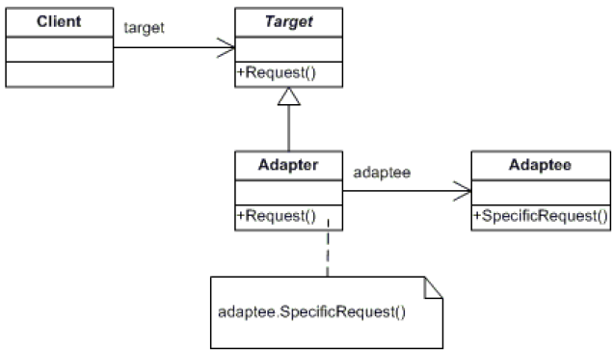
Adapter Structure

Slide 8
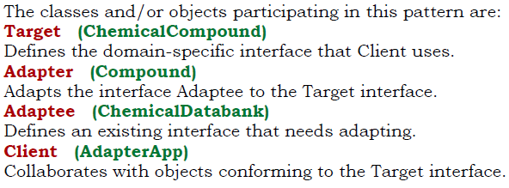
Adapter

Slide 9
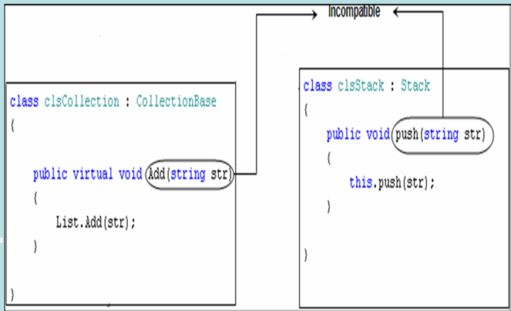
Incompatible

Slide 10
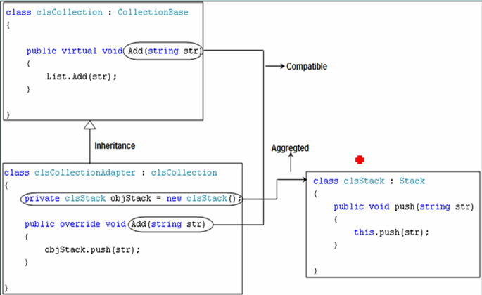
Compatible - Object Adapter

Slide 11
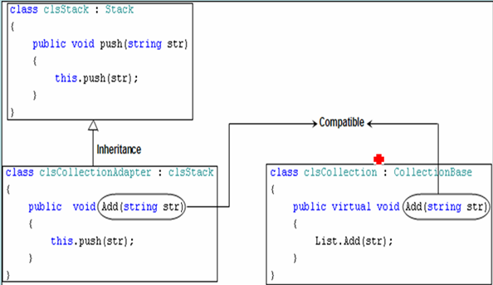
Compatible - Class Adapter

Slide 12
Bridge
Structural
Separates an object’s interface from its implementation
Definition:

Slide 13
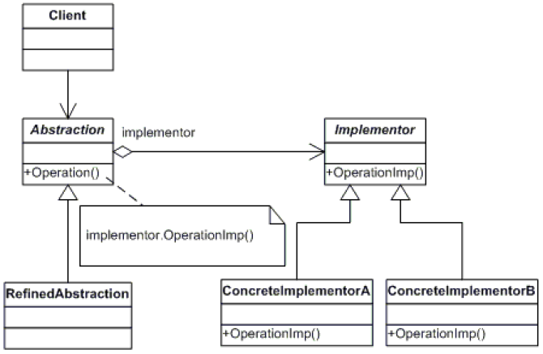
Bridge

Slide 14
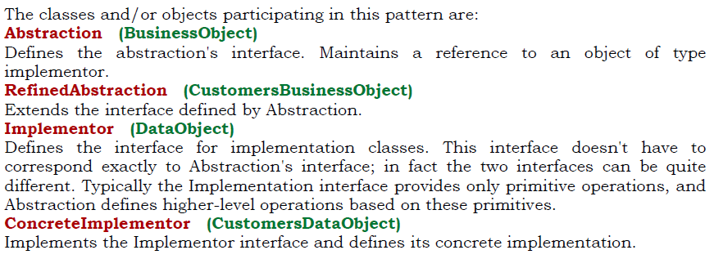
Bridge

Slide 15
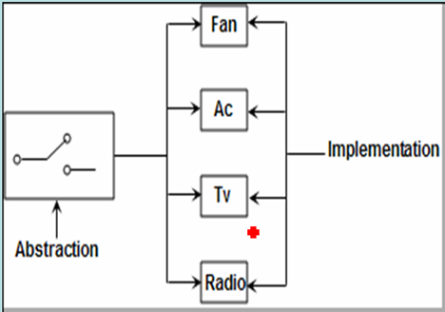
Bridge

Slide 16
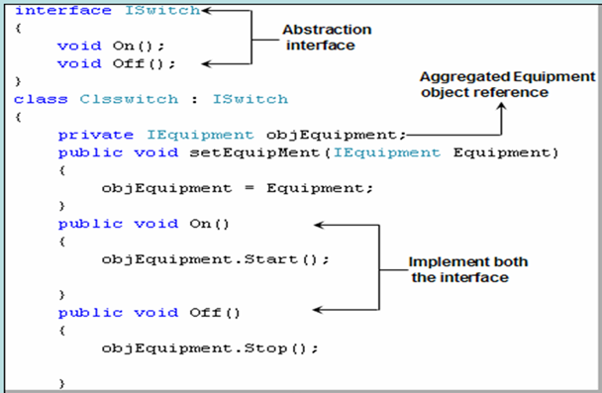
Bridge – Abstraction part

Slide 17
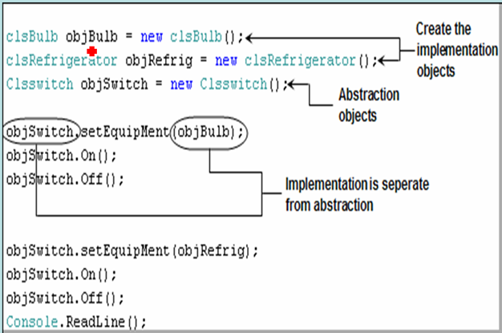
Bridge – Implementation part

Slide 18
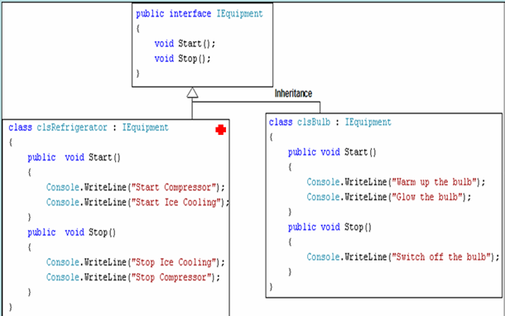
Bridge – Pattern Structure

Slide 19
Composite
A tree structure of simple and composite objects.
Allows to treat the different objects in similar fashion.

Slide 20
Composite (Structural)
Intent
Treat individual objects and multiple, recursively-composed objects uniformly
Applicability
Objects must be composed recursively,
And there should be no distinction between individual and composed elements,
And objects in the structure can be treated uniformly
Part-Whole hierarchy of objects.
Constant handling of objects as groups or individuals

Slide 21
Composite (Cont'd)
Known Uses
ET++ VObjects
InterViews Glyphs, Styles
Unidraw Components, MacroCommands
© E. Gamma, R. Helm, R. Johnson, J. Vlissides and Addison-Wesley

Slide 22
Composite (Cont'd)
Structure
© E. Gamma, R. Helm, R. Johnson, J. Vlissides and Addison-Wesley

Slide 23
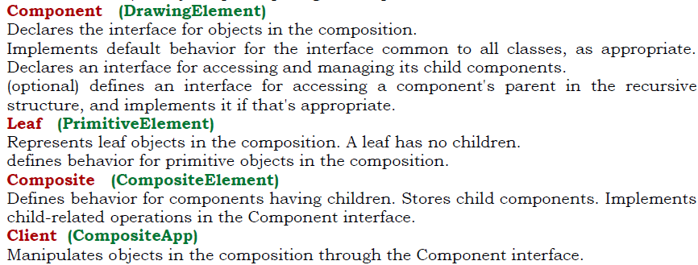
Composite

Slide 24
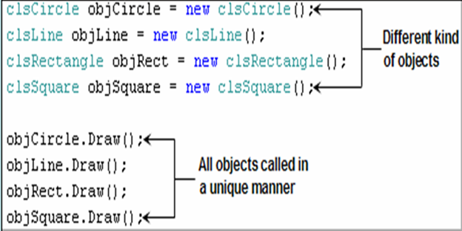
Composite

Slide 25
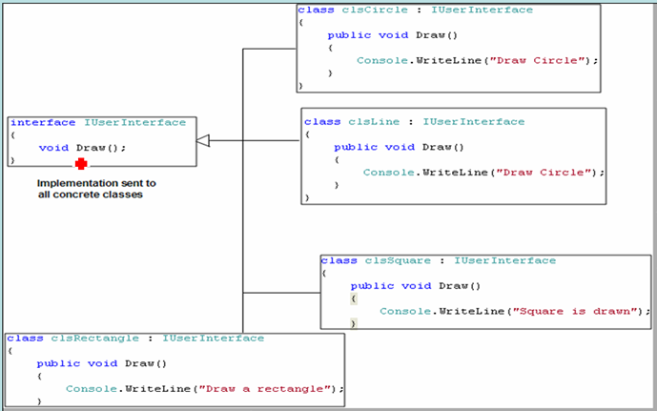
Composite

Slide 26
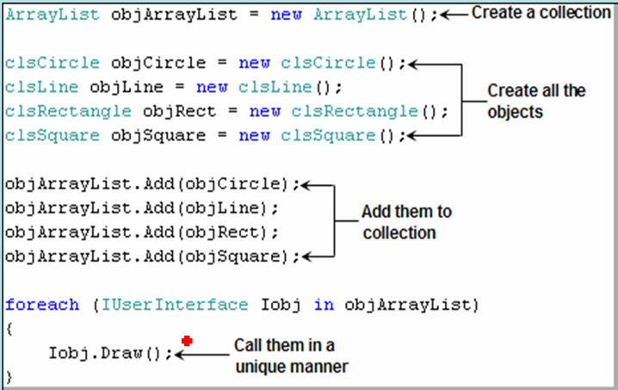
Composite

Slide 27
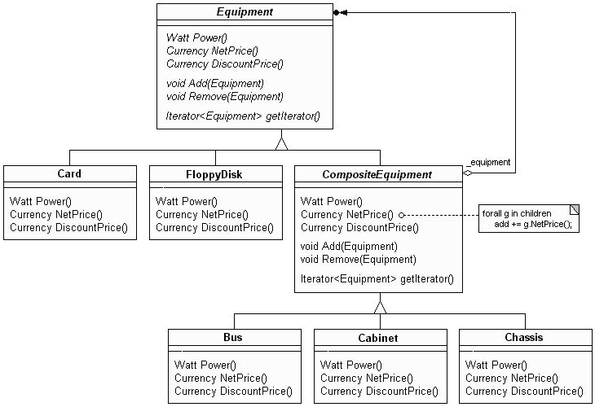
Composite - Example

Slide 28
Composite (Cont'd)
Consequences
Uniformity: treat components the same regardless of complexity
Extensibility: new Component subclasses work wherever old ones do
Overhead: might need prohibitive numbers of objects
Implementation
Do Components know their parents?
Uniform interface for both leaves and composites?
Don't allocate storage for children in Component base class
Responsibility for deleting children

Slide 29
Decorator (Structural)
Intent
Augment objects with new responsibilities
Add responsibilities to objects dynamically
Applicability
When extension by subclassing is impractical
For responsibilities that can be withdrawn
Definition
© E. Gamma, R. Helm, R. Johnson, J. Vlissides and Addison-Wesley

Slide 30
Decorator Diagram
Structure
© E. Gamma, R. Helm, R. Johnson, J. Vlissides and Addison-Wesley

Slide 31
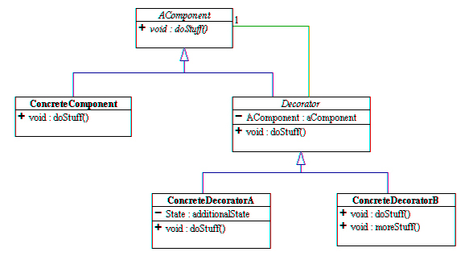
Decorator - Diagram

Slide 32
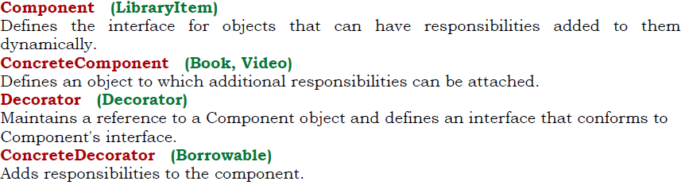
Decorator

Slide 33
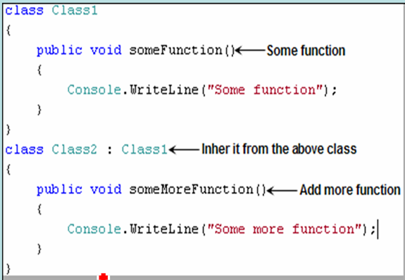

Slide 34
Decorator Overview
A Decorator, also known as a Wrapper, is an object that has an interface identical to an object that it contains. Any calls that the decorator gets, it relays to the object that it contains, and adds its own functionality along the way, either before or after the call.
Therefore, the Decorator Pattern is used for adding additional functionality to a particular object as opposed to a class of objects.
It is easy to add functionality to an entire class of objects by subclassing an object, but it is impossible to extend a single object this way. With the Decorator Pattern, you can add functionality to a single object and leave others like it unmodified.

Slide 35
Decorator Comments
The Decorator pattern gives you a lot of flexibility, since you can change what the decorator does at runtime, as opposed to having the change be static and determined at compile time by subclassing.
Since a Decorator complies with the interface that the object that it contains, the Decorator is indistinguishable from the object that it contains. That is, a Decorator is a concrete instance of the abstract class, and thus is indistinguishable from any other concrete instance, including other decorators.
This can be used to great advantage, as you can recursively nest decorators without any other objects being able to tell the difference, allowing a near infinite amount of customization.

Slide 36
Decorator (Cont'd)
Consequences
Responsibilities can be added/removed at run-time
Avoids subclass explosion
Recursive nesting allows multiple responsibilities
Interface occlusion
Identity crisis
Implementation
Interface conformance
Use a lightweight, abstract base class for Decorator
Heavyweight base classes make Strategy more attractive
© E. Gamma, R. Helm, R. Johnson, J. Vlissides and Addison-Wesley

Slide 37
Decorator (Cont'd)
Known Uses
Embellishment objects from most OO-GUI toolkits
ParcPlace PassivityWrapper
InterViews DebuggingGlyph
© E. Gamma, R. Helm, R. Johnson, J. Vlissides and Addison-Wesley

Slide 38
Facade
A single class that represents an entire subsystem
Definition

Slide 39
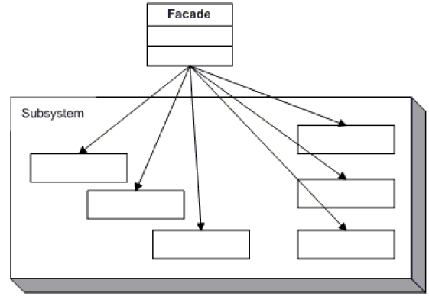
Facade

Slide 40
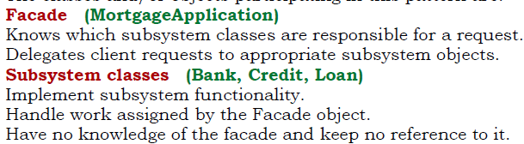
Facade

Slide 41
Façade
Façade
© E. Gamma, R. Helm, R. Johnson, J. Vlissides and Addison-Wesley

Slide 42
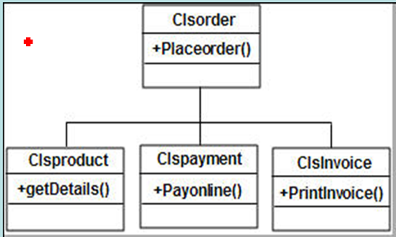
Façade

Slide 43
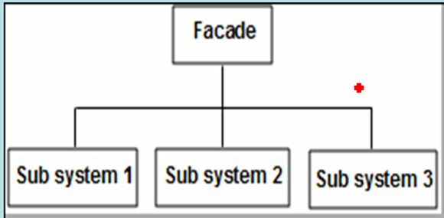
Façade

Slide 44
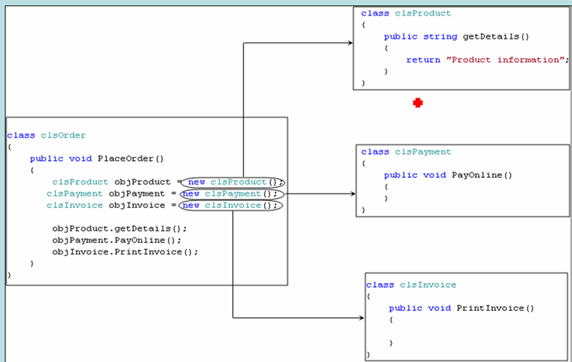
Façade

Slide 45
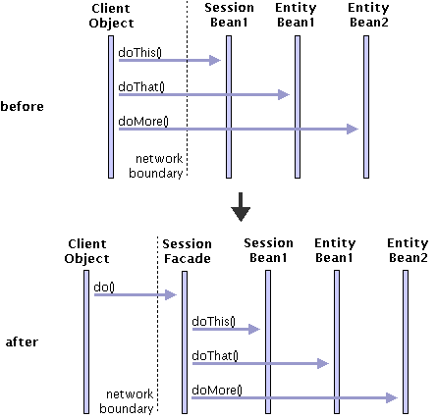
Façade

Slide 46
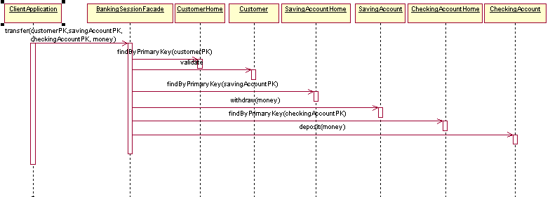
Façade - Example

Slide 47
Facade Overview
Example: WYSIWYG Editor (Cont'd)
Spelling checking & hyphenation
Iterator
Visitor
Some more patterns
Template Method
Singleton
Façade
Observations and Conclusions
Further reading

Slide 48
Flyweight pattern
A fine-grained instance used for efficient sharing
Where we need to create many objects and all these objects share some kind of common data.

Slide 49
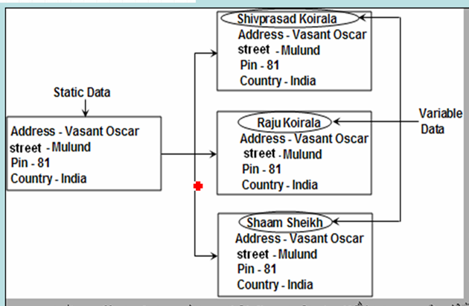
Flyweight pattern

Slide 50
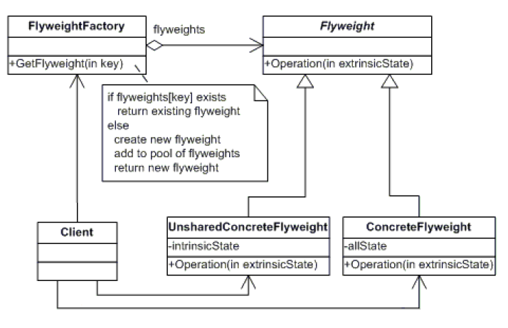

Slide 51
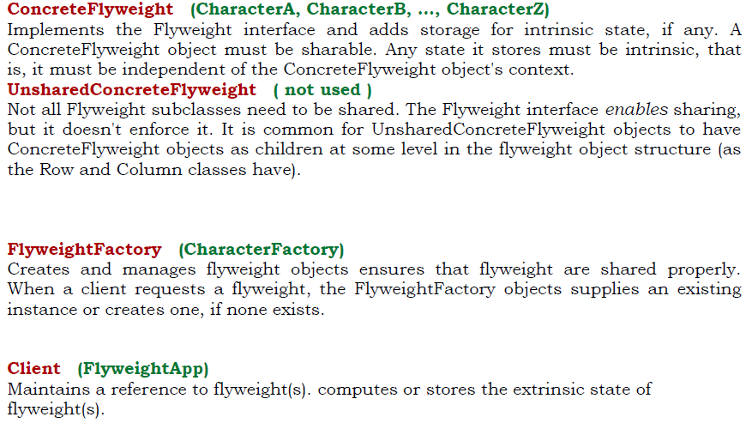

Slide 52
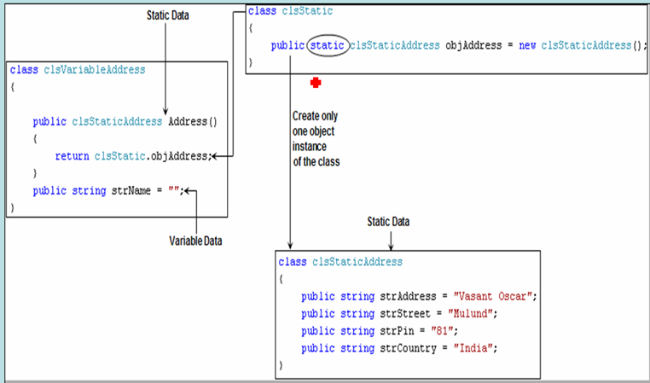
Flyweight pattern

Slide 53
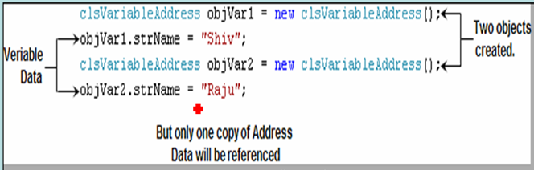
Flyweight pattern

Slide 54
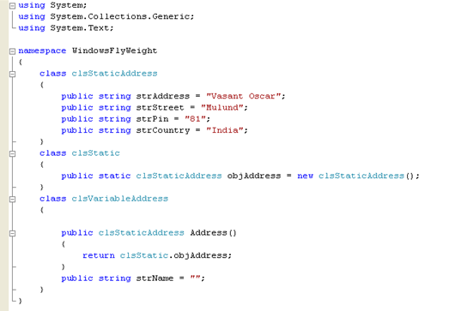
Flyweight pattern

Slide 55
Proxy
An object representing another object.
A well-known example of the proxy pattern is a reference counting pointer object.
Definition

Slide 56
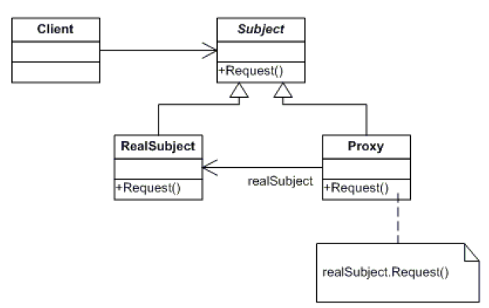

Slide 57
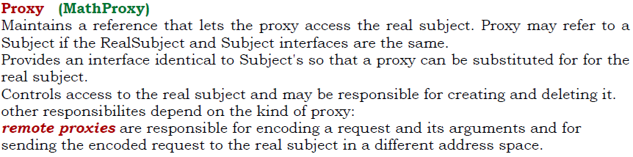
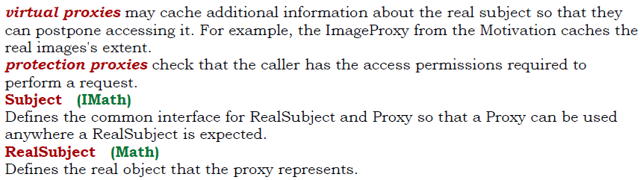

Slide 58
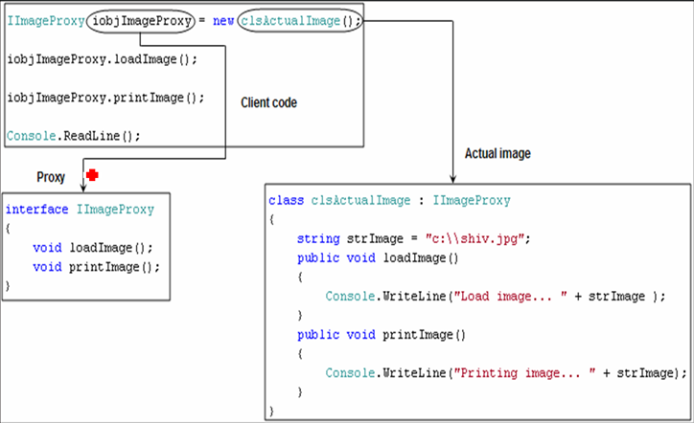
Proxy

Slide 59
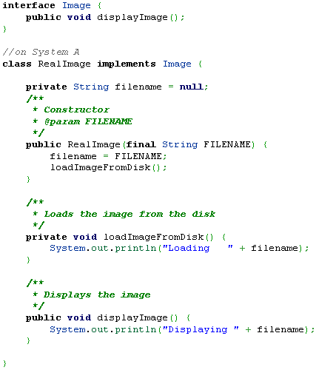

Slide 60
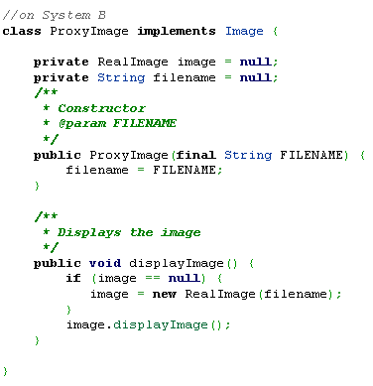

Slide 61
